Slide 1
Wave Tank
Will Coburn
Gabriel Nava

Slide 2
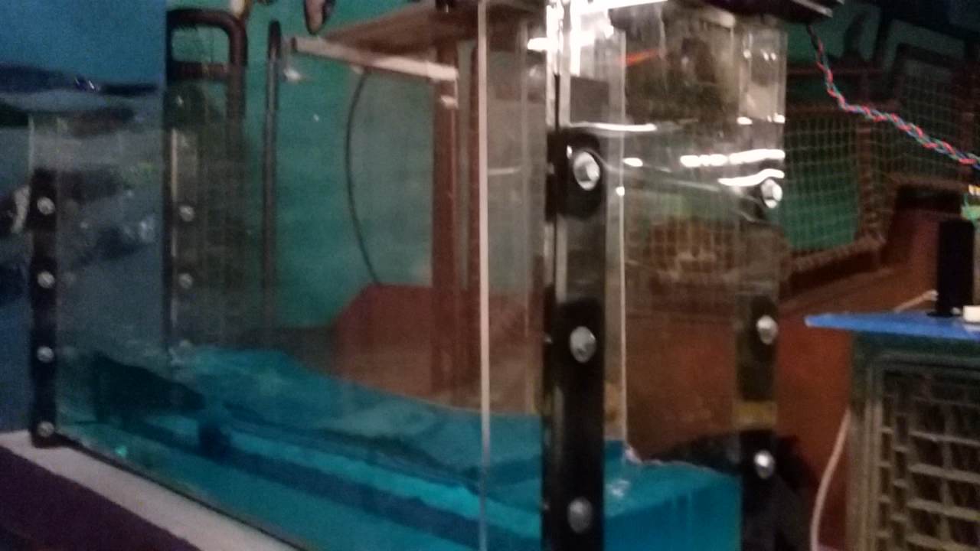
Progress to date

Slide 3
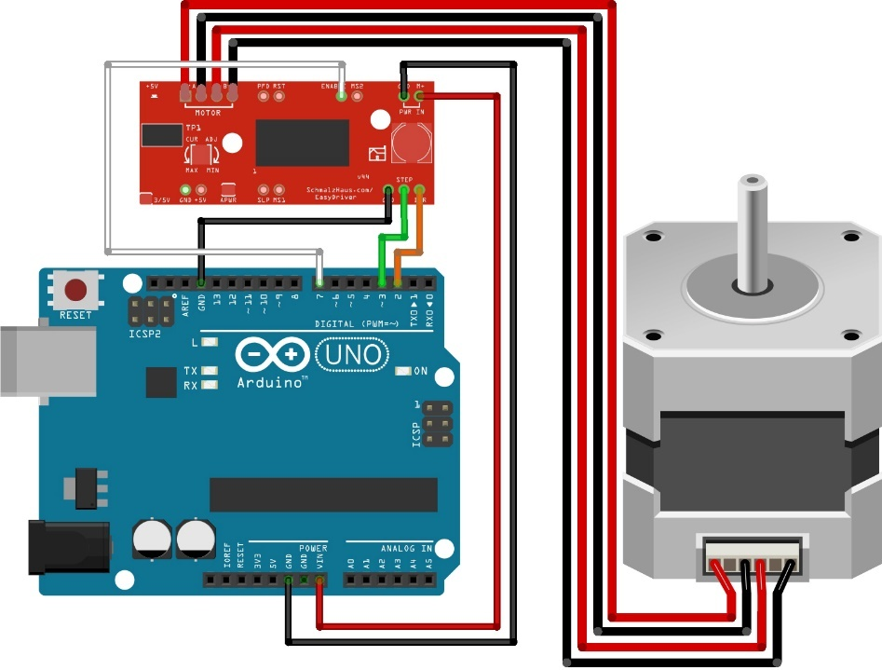
Problematic Issues
Leaks
Runtime Control of Motor Speed and Direction

Slide 4
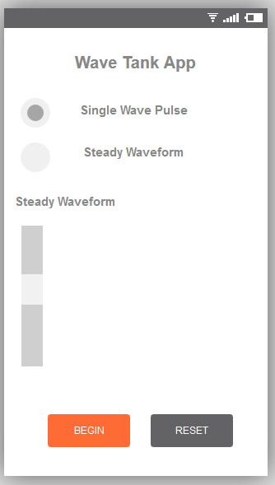
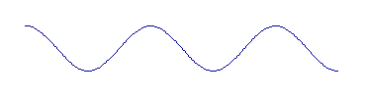
Going Forward
Use Raspberry Pi and Control Motor over WiFi
Over-seal leaks with silicon
GUI

